Slide 1
Uncertainty in measuring schemes

Slide 2
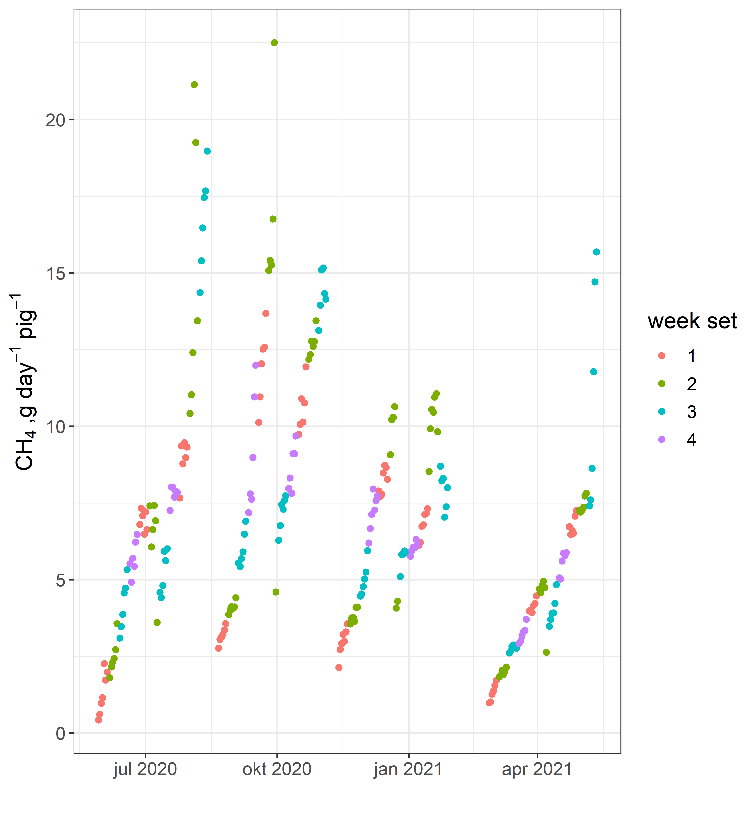
Two Methods for selecting schemes
Method:
1 measuring period = 7 days
Four predefined ”week sets” were made
set1: 1, 5, 9,
set2: 4, 8, 12,
set3: 3, 7, 11
set4: 2, 6, 10

Slide 3
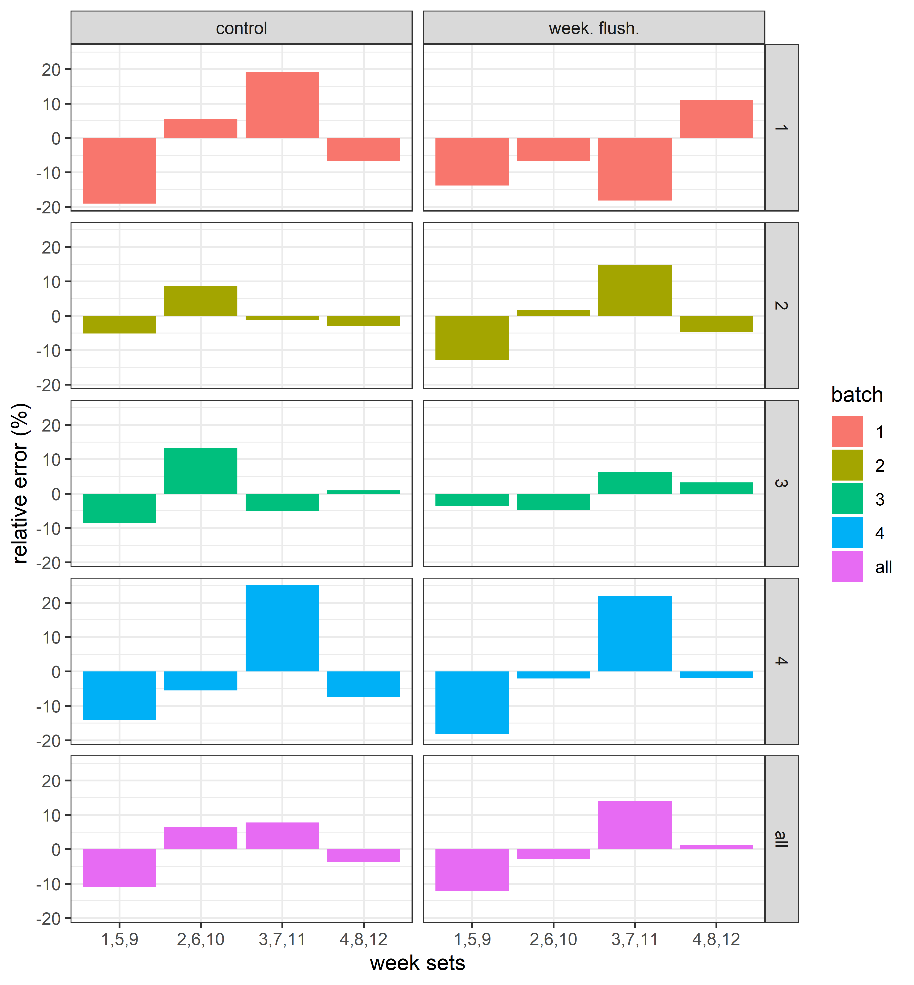
The partial datasets were compared to the full
Dataset to calculate error
set1: 1, 5, 9,
set2: 4, 8, 12,
set3: 3, 7, 11
set4: 2, 6, 10

Slide 4
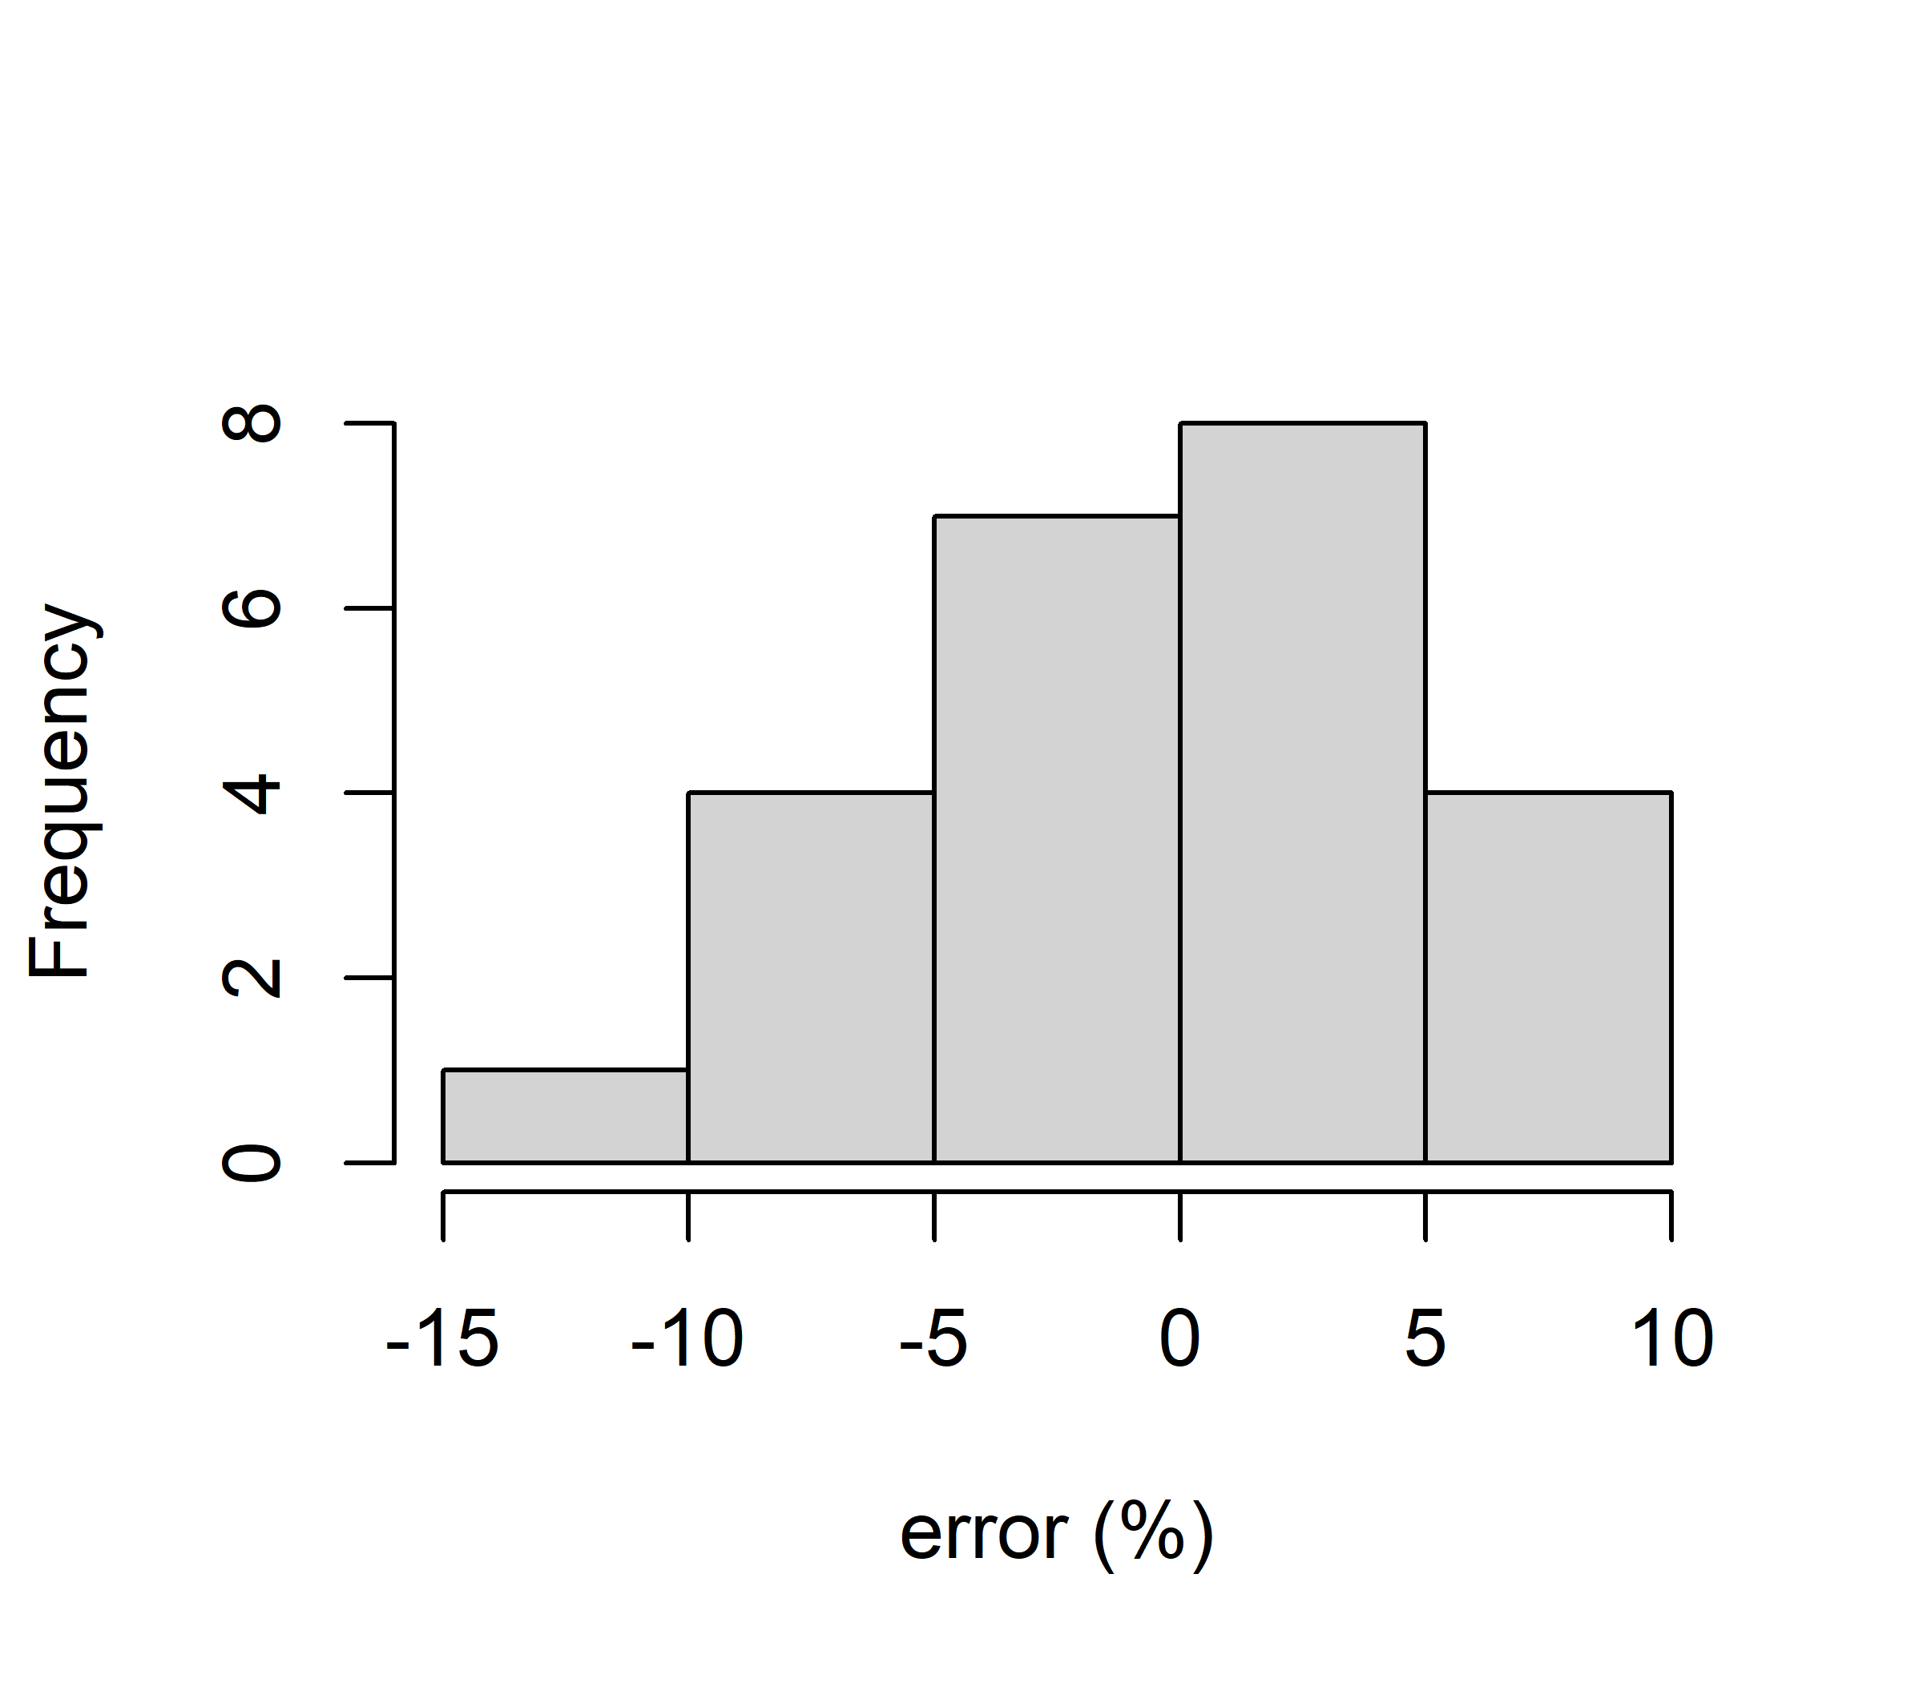
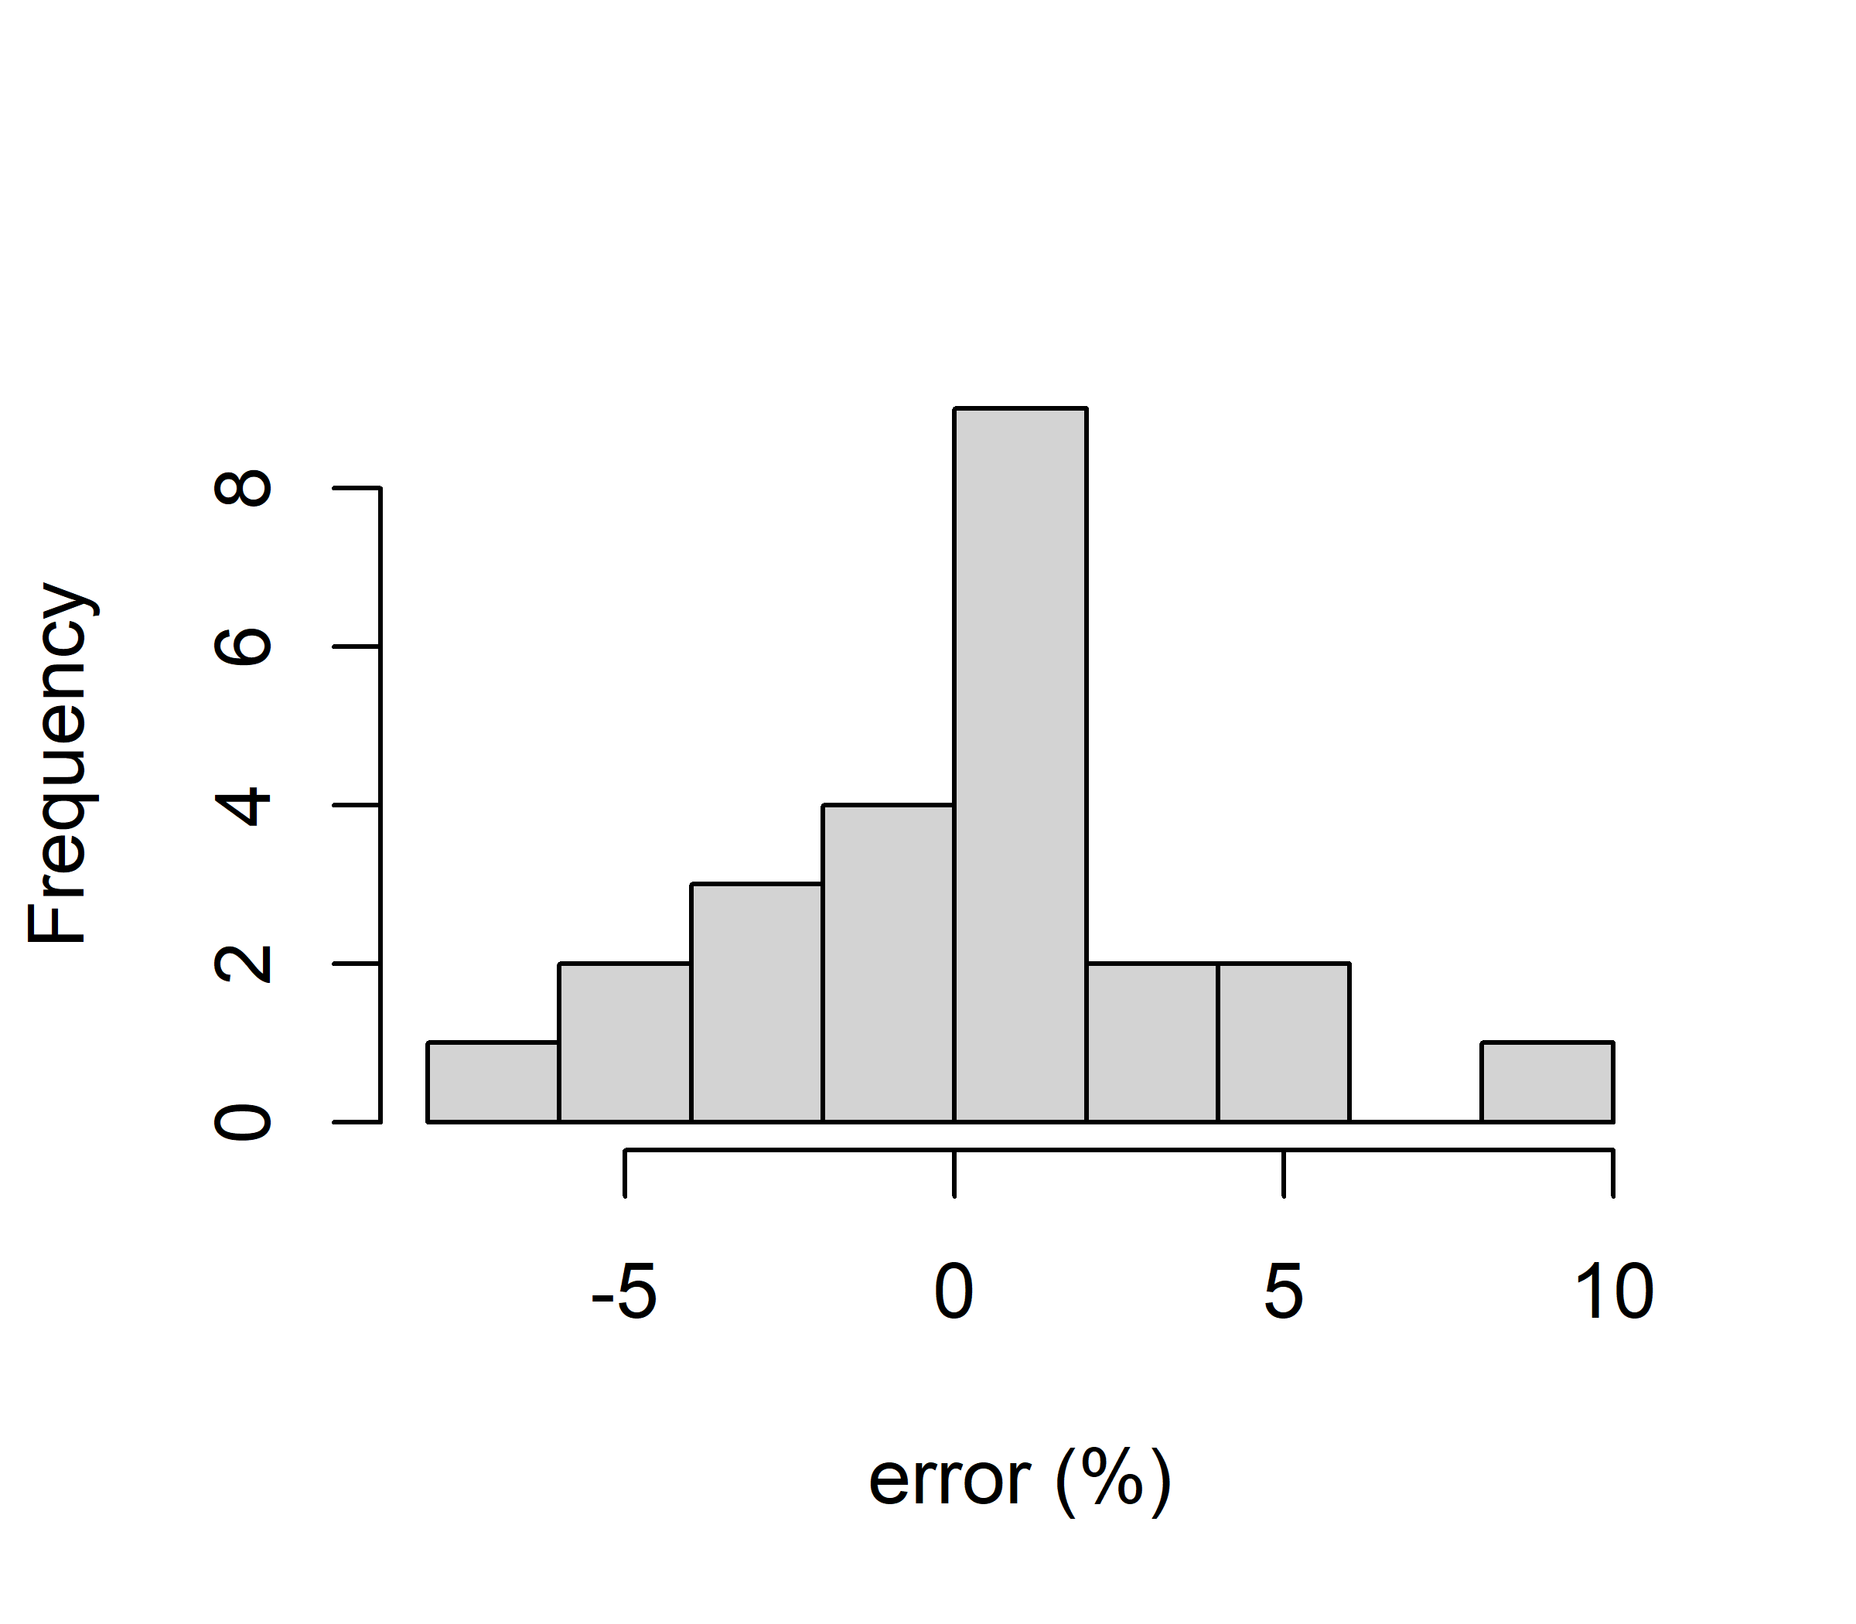
Mean error = 0.24%
Std error = 4.96%
Randomly assigning week sets to the batches in 100 simulations
Then removing replicates
(since there should be only 24 possible combinations)
We could identify the week sets with the lowest combined error,
But does it make sense? Could be linked to just this data set, which
was from a pilot plant with no prior good inoculum…
control
Mean error = -0.036%
Std error = 3.41%
Week flushing

Slide 5
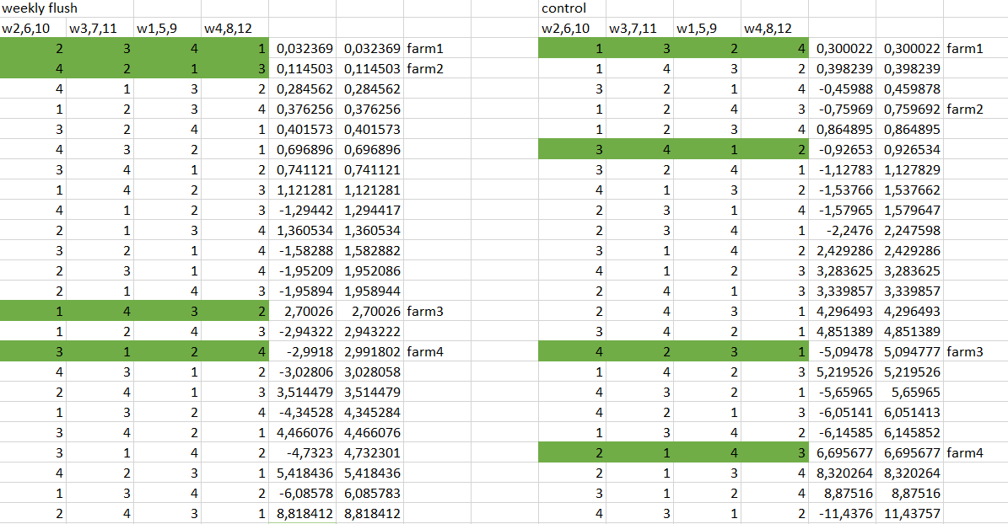

Slide 6
What if we reduce number of weeks to 10
set1: 1, 9
set2: 4, 8
set3: 3, 7, 11
set4: 2, 6, 10
Control:
Mean error = -1.197
Sd error = 5.93
Weekly:
Mean error = 0.92
Sd error = 3.30
set1: 1, 5, 9
set2: 4, 8
set3: 3, 7, 11
set4: 2, 10
Control:
Mean error = -1.356
Sd error = 5.18
Weekly:
Mean error = 0.446
Sd error = 3.53
set1: 5, 9
set2: 4, 8
set3: 3, 7, 11
set4: 2, 6, 10
Control:
Mean error = 7.129
Sd error = 5.34
Weekly:
Mean error = 4.69
Sd error = 3.8
set1: 1, 5, 9
set2: 4, 8
set3: 3, 7
set4: 2, 6, 10
Control:
Mean error = -7.95
Sd error = 5.03
weekly:
Mean error = -6.7
Sd error = 2.85

Slide 7
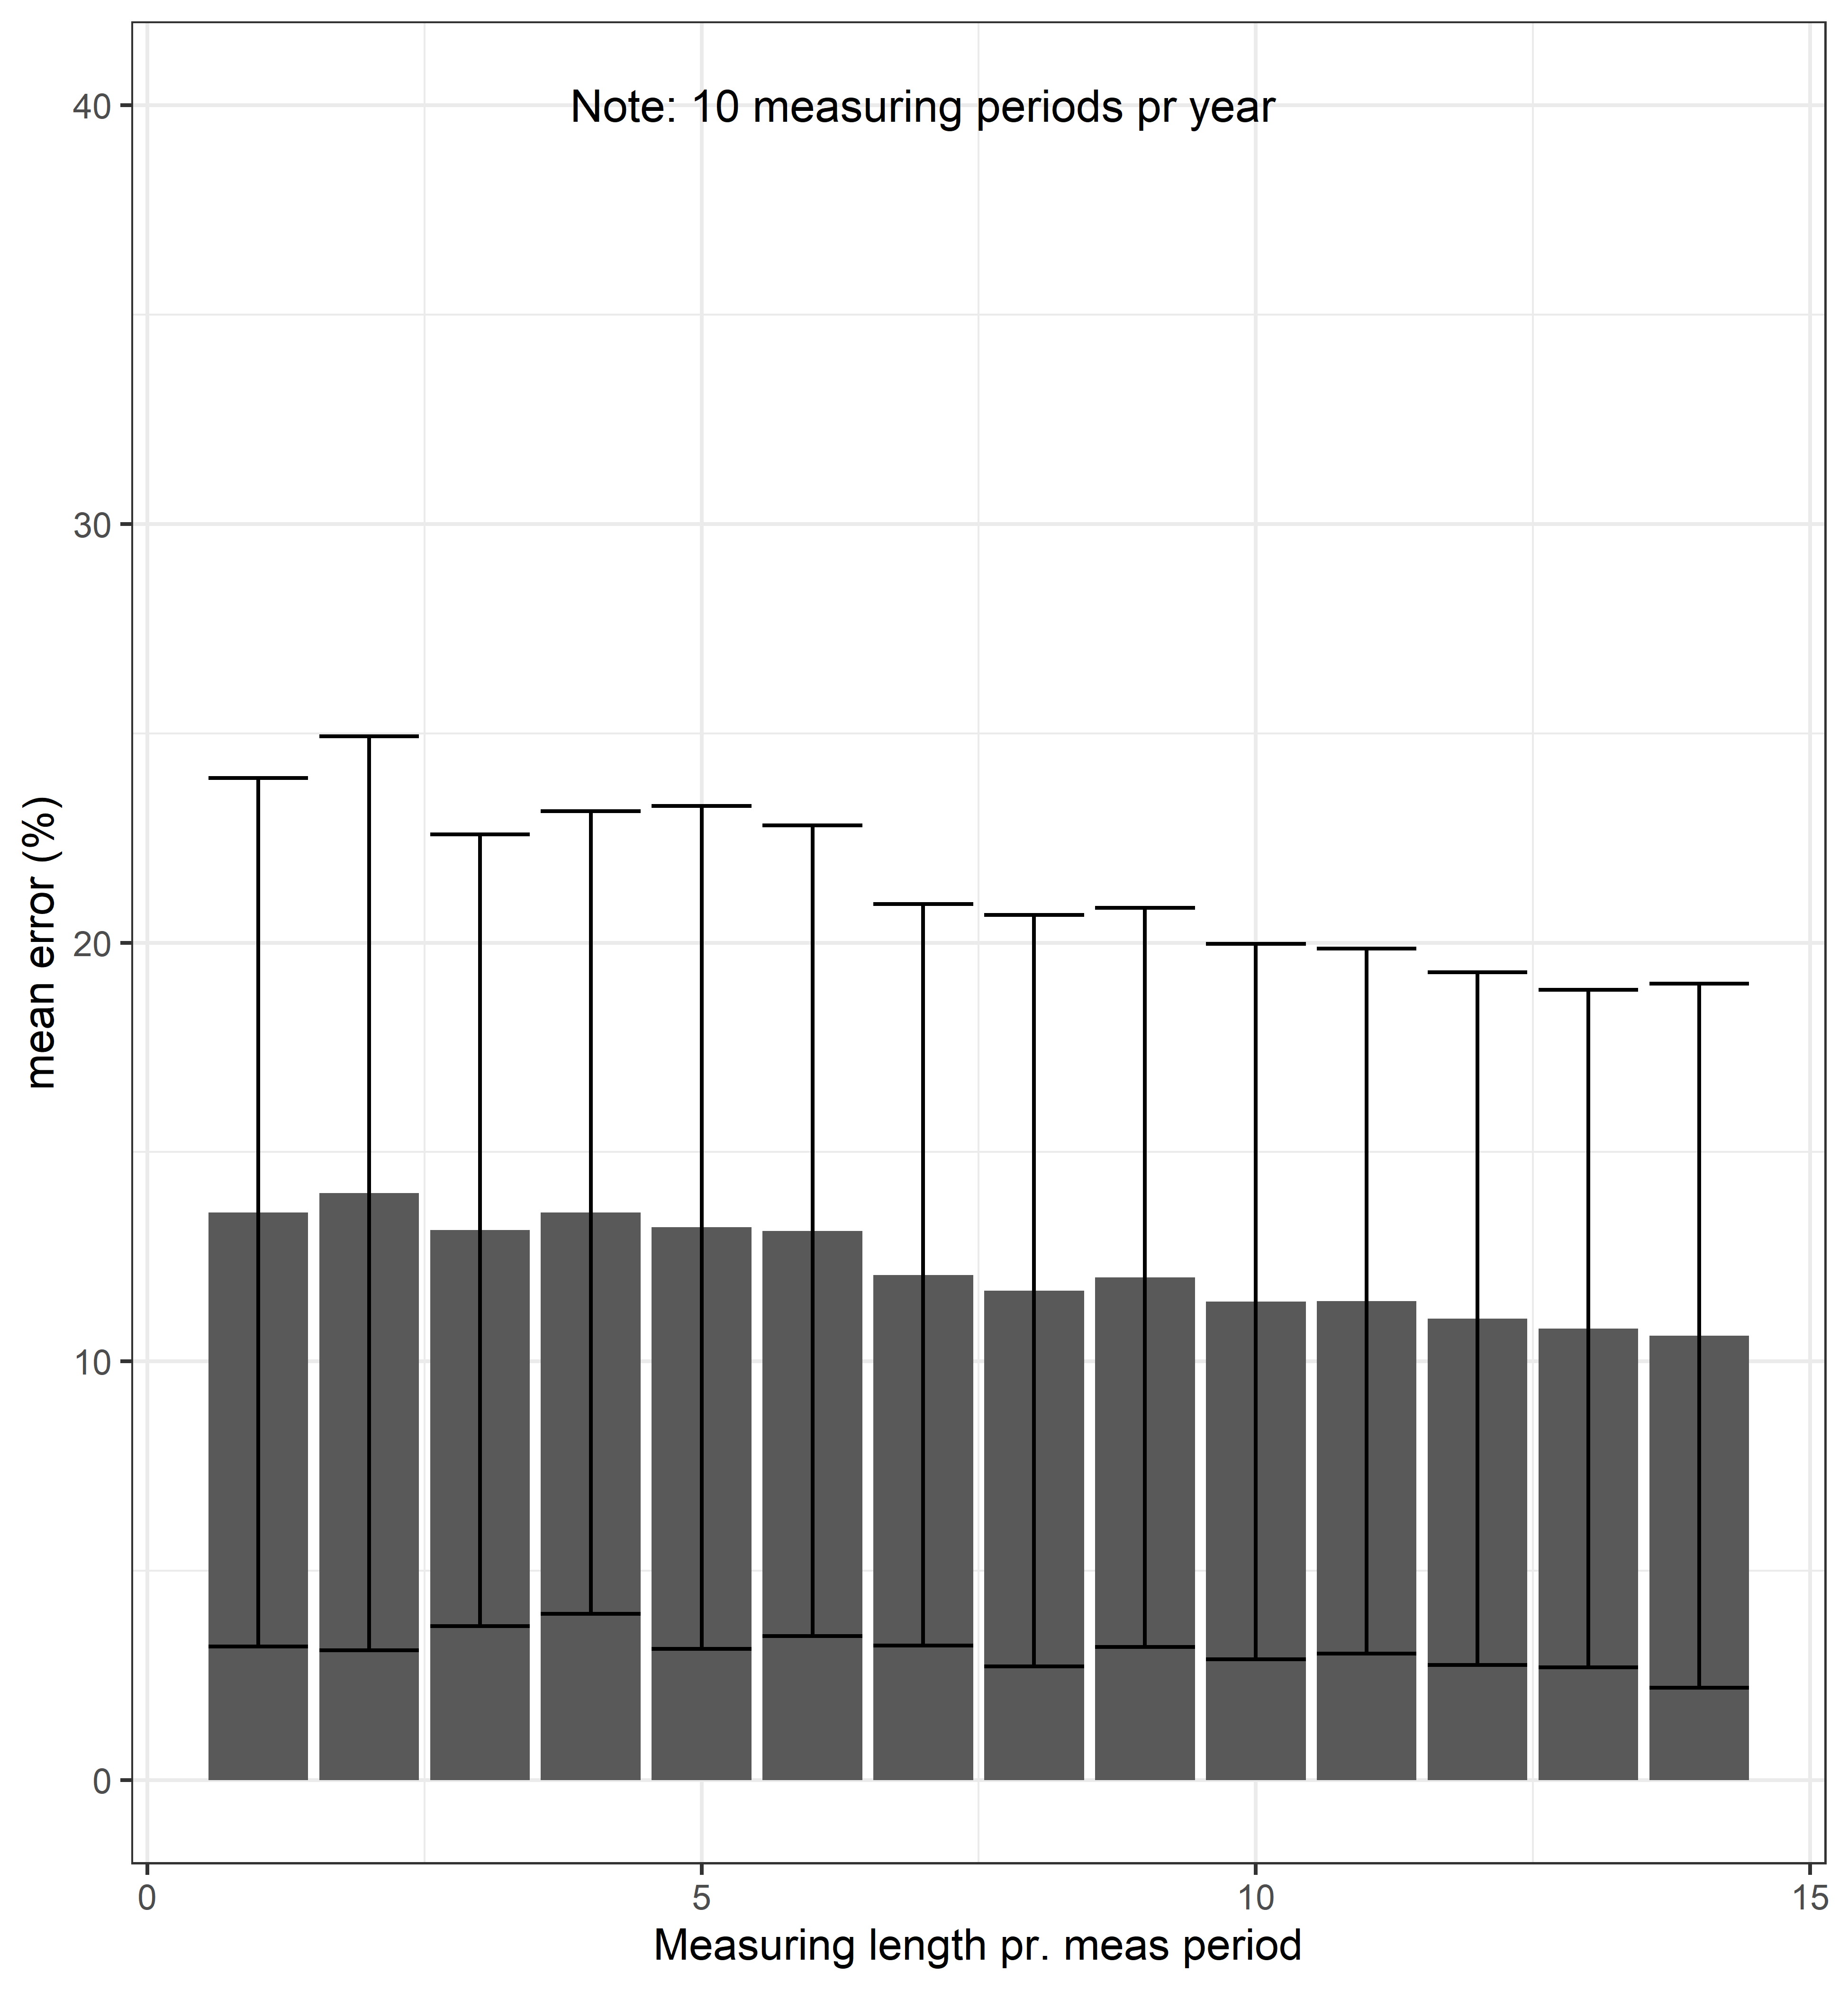
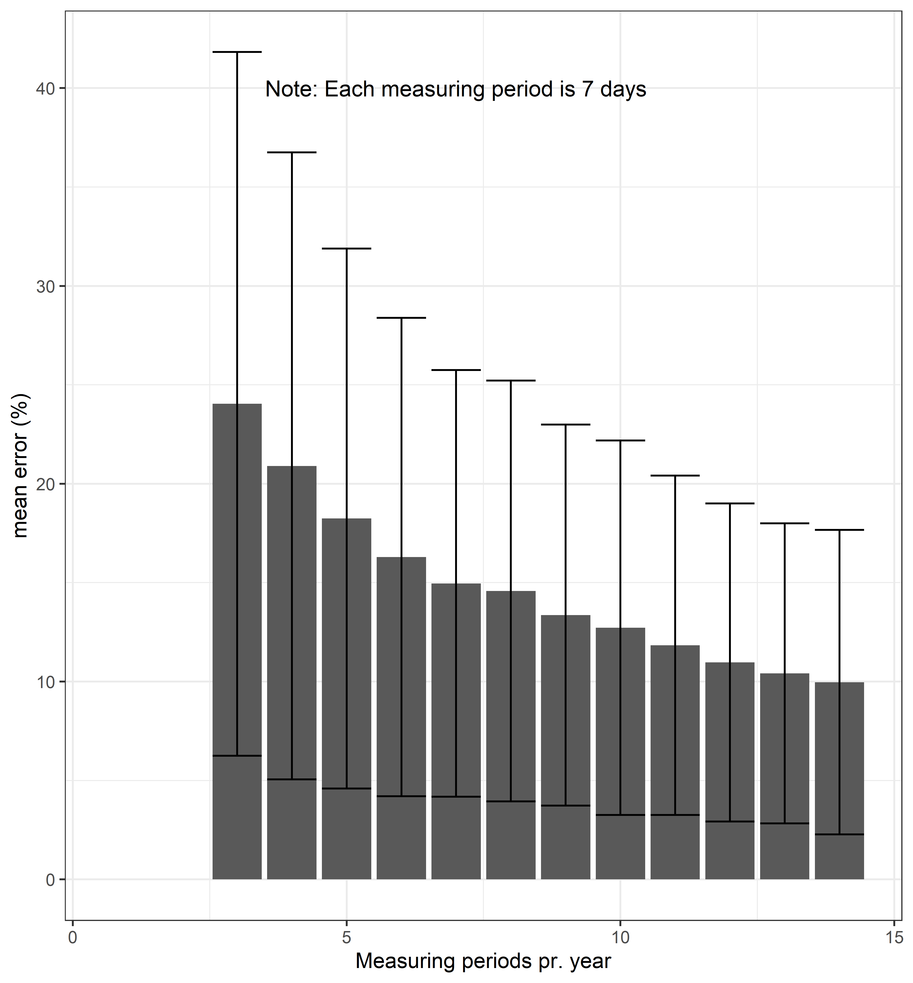

Slide 8
